Slide 1
Airline Sentiment Analysis Feb. 2015 - Aug 2019
Analysis by:
Md Sharif Mia

Slide 2
Data Analyzed & Methodology

Slide 3
Situation
Air travel is cheaper than ever before – but how do customers feel?
Have airline sentiments changed over the past 4 years?
Are tweets about certain airlines more positive or negative?
How drastically has sentiment changed?
What are nationwide studies reporting? Why does it matter?

Slide 4
Data Analyzed
Twitter US Airline Sentiment from February 2015
Dataset pulled from Kaggle.com
14,640 tweets referencing 6 major airlines
American, Jet Blue, Southwest, United, US Airways, Virgin America
Comparative dataset from August 2019
Dataset scraped directly from Twitter in real-time
9,140 tweets referencing 4 major airlines
American, Jet Blue, Southwest, United
US Airways & Virgin America have since been absorbed by other airlines (by American and Alaskan Air, respectively)

Slide 5
Hypotheses
#1: At least one airline’s sentiment has improved since 2015
#2: Southwest still has a more positive sentiment than negative one
#3: At least one airline’s sentiment is more negative in 2019

Slide 6
Methods
Retrieve Data
CSV File
Scrape tweets on Twitter
Clean & Import Data
Excel
Python
Perform sentiment and general analysis
VADER
Python visualizations
Google Colab
Define: VADER Sentiment Analysis
A model used for text sentiment analysis that is sensitive to both polarity (positive/negative) and intensity (strength) of emotion.
Uses a combination of a sentiment scale from -4 to +4 (with 0 being neutral) and the average ratings for each word by a number of human raters – calculated scores + collective opinion.
When implemented in Python, sentiment score is normalized to a scale of -1 to +1
Five heuristics are also applied, quantified using human raters
Punctuation, Capitalization, Degree Modifiers, “But” checker, List of negator words
* Source

Slide 7
Results

Slide 8
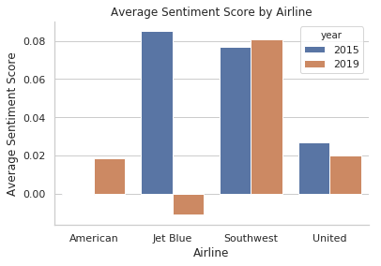
Average Sentiment Score
Southwest and United have maintained consistent average sentiment scores from 2015 to 2019

Slide 9
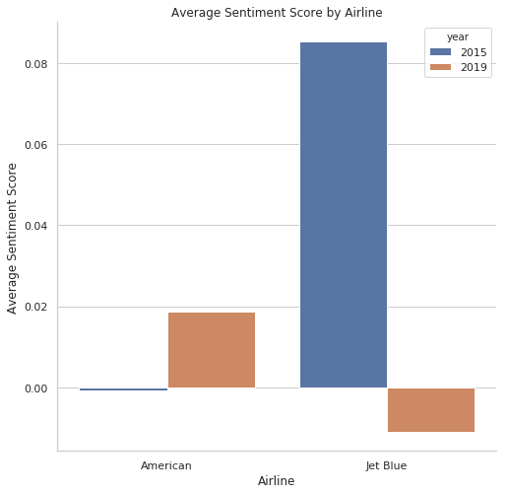
American Airlines & JetBlue
American Airlines' average sentiment score increased from -0.002 to 0.019
Jet Blue’s average sentiment score decreased from 0.08 (VERY HIGH) to -0.01
1050%
112.5%

Slide 10
Hypotheses Were Validated
#1: At least one airline’s sentiment has improved since 2015
American Airlines' sentiment improved from a neutral score to a positive score
#2: Southwest still has a more positive sentiment than negative one
Southwest Airlines' sentiment is still going strong!
#3: At least one airline’s sentiment is more negative in 2019
JetBlue’s sentiment had a surprisingly drastic decrease since 2015

Slide 11
HOWEVER…
Are consumer tweets uncovering a different reality than what is being reported?

Slide 12
Nationwide Reports Reveal A Different Story
Airline Quality Rating (2019 report) – 9 total airlines
JetBlue ranked #2 (up from #3 ranking in 2018)
American Airlines ranked #8
American Consumer Satisfaction Index (2019)
JetBlue tied for #1 (tied with Southwest)
American ranked #5
Wallethub Data Analysis (reported on 2018 data)
JetBlue ranked #8
American Airlines ranked #10
JetBlue
American Airlines
*See Appendix slide for source information

Slide 13
Why Does It Matter?
Creates a possibly skewed reality
Will customers ever be heard if airline satisfaction studies report opposing results?
Actual public opinion won’t drive important decisions
Why would an airline change its system if studies show customer satisfaction?
Airline initiatives don’t evaluate actual sentiments
Future growth objectives and marketing goals could be targeting the wrong results

Slide 14
Who Cares?
Airlines
Overall satisfaction or ongoing complaints by customers is an important factor
A steady increase or decrease of customer satisfaction will eventually catch up with the airline
Customers
People trust other people’s opinions and may base future air travel decisions on general sentiments they see on Twitter & other social media platforms
Marketing teams
How do you target potential customers if you don’t know who those customers actually are?
The success of a marketing campaign relies on the strength of results – are those results skewed if reported opinion and social media opinion show complete opposition?

Slide 15
Next Steps
Scrape more tweets
Possibly from previous years to uncover any patterns in sentiment differences
Perform analysis on other domestic airlines – see if there’s differing results with those as well
Delta, Alaskan, Frontier, Spirit, etc.
Analyze reporting metrics
How many people are being surveyed and how much data is being analyzed in these nationwide reports? Is it enough to provide a clear picture of sentiment?
Who is funding the studies and reports?
Conduct an airline survey
Control parameters around survey questions and participants to collect comparable dataset to 2019 tweets

Slide 16
THANK YOU!

Slide 17
Appendix

Slide 18
Nationwide Studies Sources
*Source #1: Airline Quality Rating report compiled by researchers at Wichita State University and Embry-Riddle Aeronautical University based on their ranking on government-reported data on mishandled baggage, consumer complaints, on-time performance and involuntary denied boardings.
*Source #2: American Consumer Satisfaction Index is an independent national benchmark of consumer experiences of products and services sold to U.S. consumers.
*Source #3: Wallethub collected and analyzed 2018 flight data from the U.S. Department of Transportation and compiled the list using a strategic methodology that compared 15 key metrics across four major categories, including baggage, departures and complaints; animal incidents; in-flight comfort and cost; and safety.

